Slide 1




Shark Tank India
EXPLORATORY
DATA ANALYSIS
-Adarsh Sahu

Slide 2

PROJECT DETAILS

Slide 3




Overview
Introduction
Objectives
Dataset Description
Project Goals
Results
Summary/ Conclusion
Contact Us
01
02
03
04
05
06
07

Slide 4


Introduction
Shark Tank India is a Hindi-language business reality television series that airs on Sony Entertainment Television. The show is an Indian adaptation of the American television series Shark Tank. It shows entrepreneurs giving business presentations to a panel of investors or sharks who decide whether to invest in their company.

Slide 5
Objectives
The aim of Exploratory Data Analysis (EDA) can be summarized in five key points:
1. Understanding Data Structure: EDA helps to understand the overall structure, distribution, and patterns within the dataset, including missing values, outliers, and anomalies.
2. Hypothesis Generation: It assists in generating hypotheses by identifying trends, correlations, and relationships among variables, guiding further analysis or modeling.
3. Data Cleaning and Preprocessing: EDA helps detect and address data quality issues such as missing or inconsistent data, allowing for more accurate modeling and analysis.
4. Feature Selection: By exploring the dataset, EDA can reveal which features or variables are most important, aiding in dimensionality reduction and improving model performance.
5. Visualization: EDA uses visual techniques (e.g., plots, charts) to summarize and communicate key findings, making complex data more understandable and facilitating better decision-making.

Slide 6










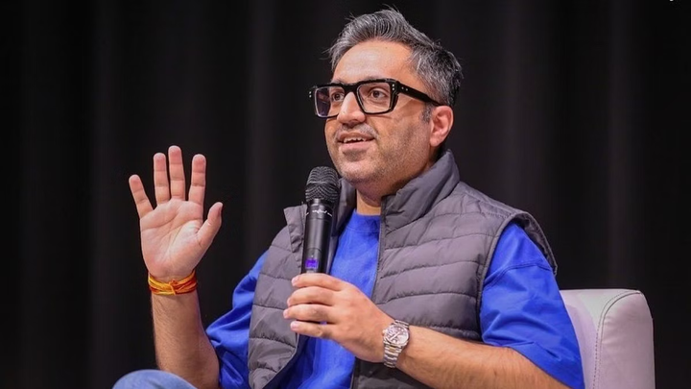
Shark Gallery

Slide 7
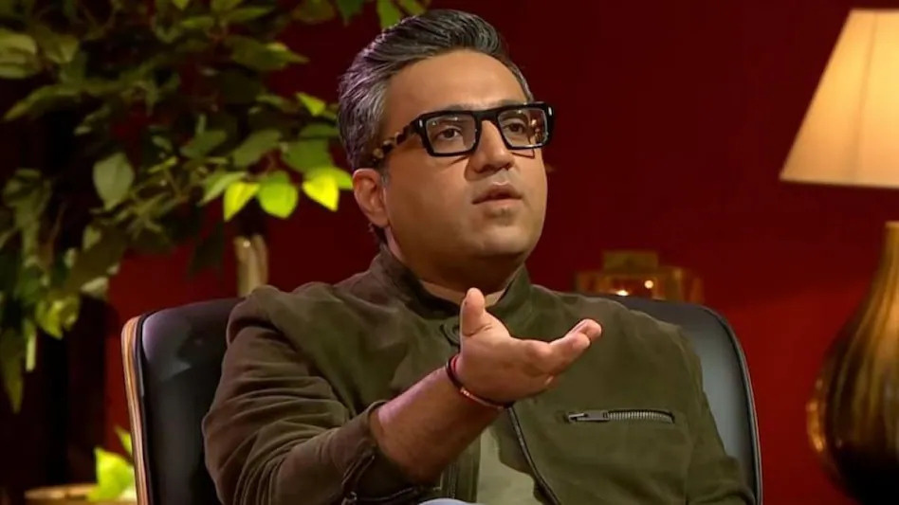



Data Overview
Data Source: Kaggle
Data Variables
78 Attributes/Columns
Total 478 Records/Rows
Data Description
Startup Name
Pitch Details
Season Telecast Details
Industry name or type
Business Description
Presenter Details (Gender, Age, City, State)
Monetary Details of Business (Sales, Revenue, EBITDA, Margins, Cash Burns)
Ask Details(Money and equity asked vs offered)
Equities/Debt/Valuation of each Pitch
Deal Results(Grabbed or not)
Total Deal Amount - Total Deal Amount, in lakhs INR
Guests Present

Slide 8



Data Cleaning and Preparation
Handled missing values.
Removed duplicates.
Transformed categorical variables (e.g., sector types).
Created new variables (e.g.feature engineering for states, investment-to-request ratio).
Libraries Utilized:
Numpy
Pandas
Seaborn
Matplotlib

Slide 9
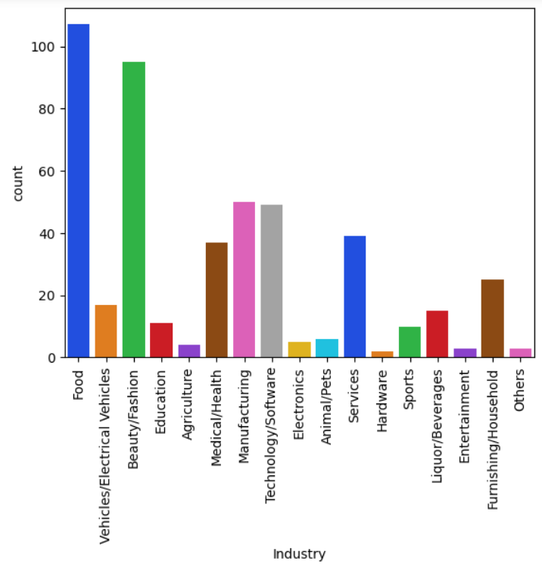
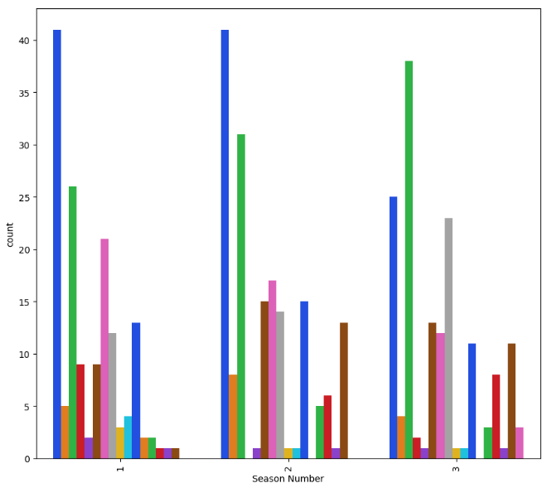
Industry and sector-wise distribution of companies
Distribution of Business ideas as per Industry seactor across Seasons

Slide 10
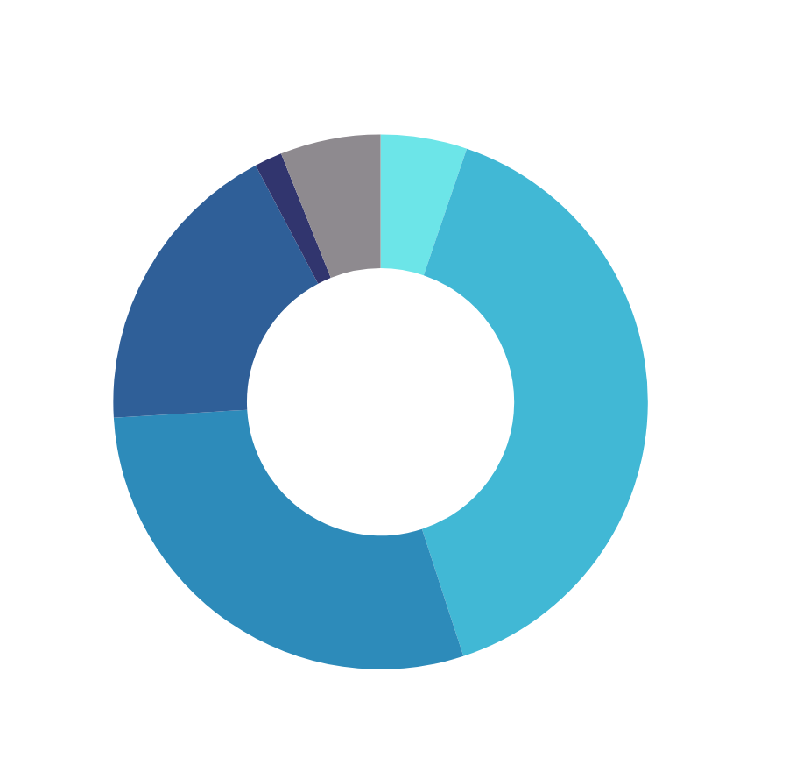
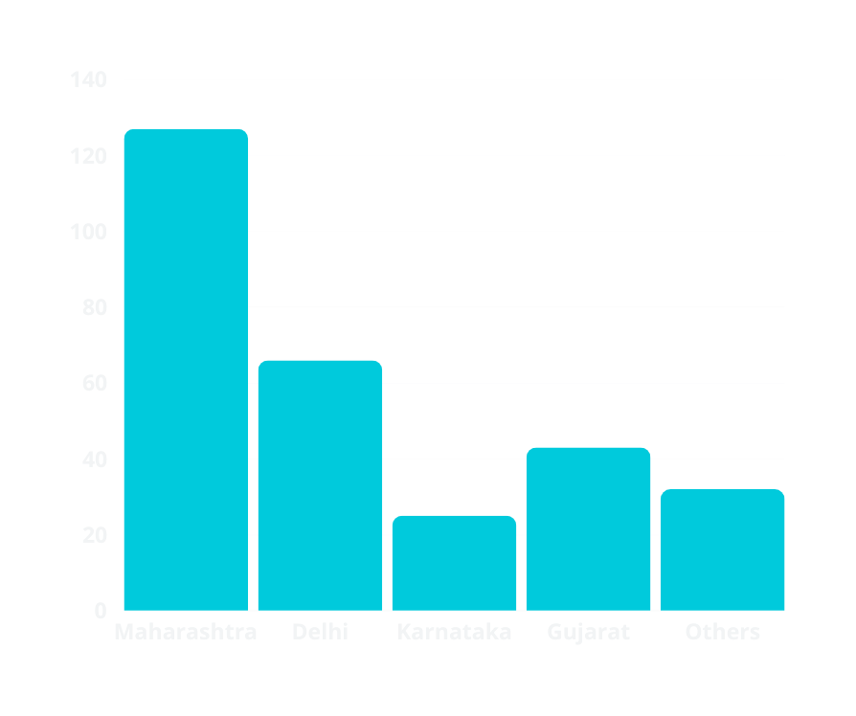
Industry and sector-wise distribution of companies
Count
Top 5 participating States
Zone-wise analysis of Pitches

Slide 11

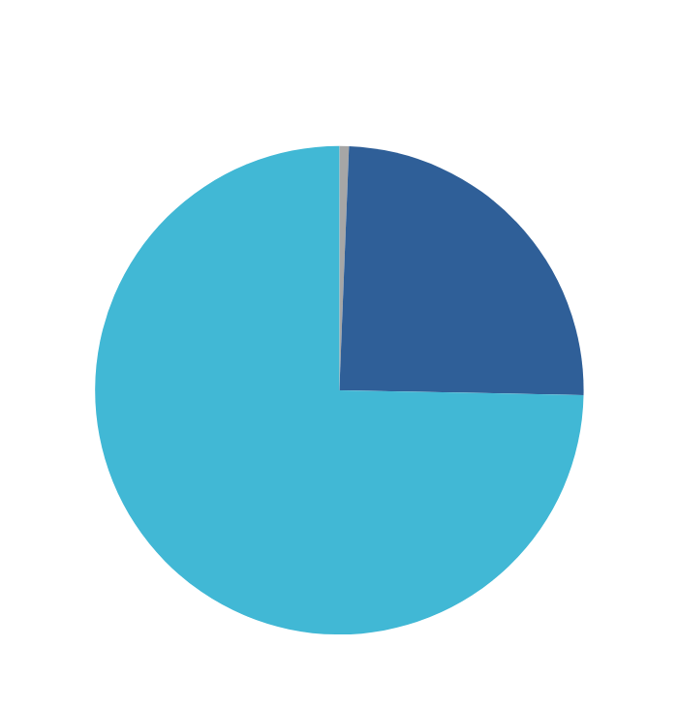
Presenter Details
Count
Season
Couple presenters in each Season
Age Dynamics of participants

Slide 12
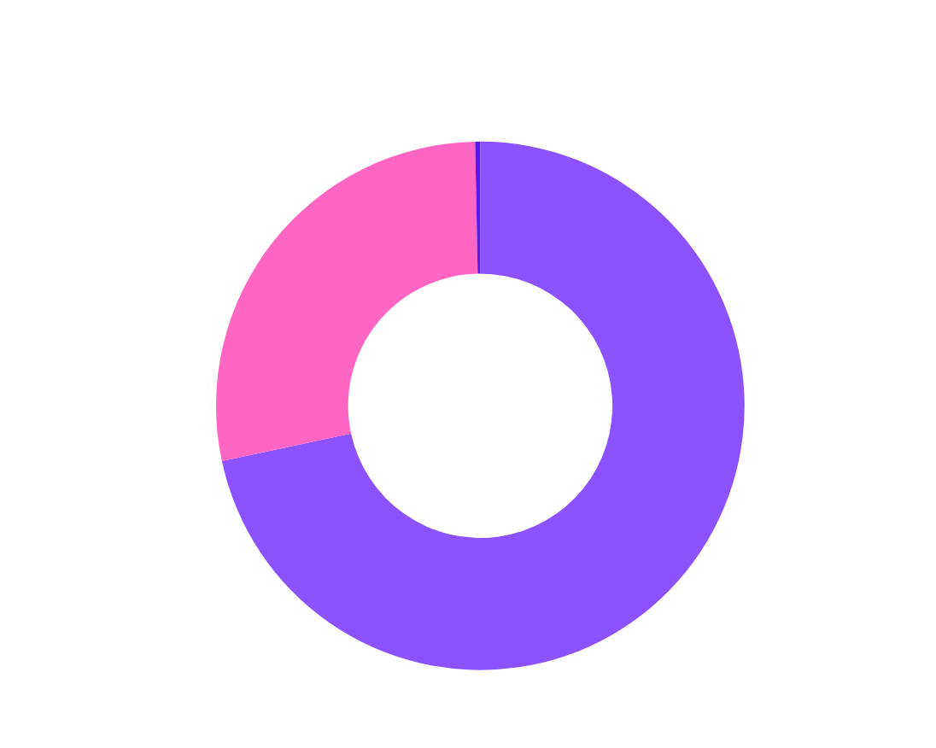
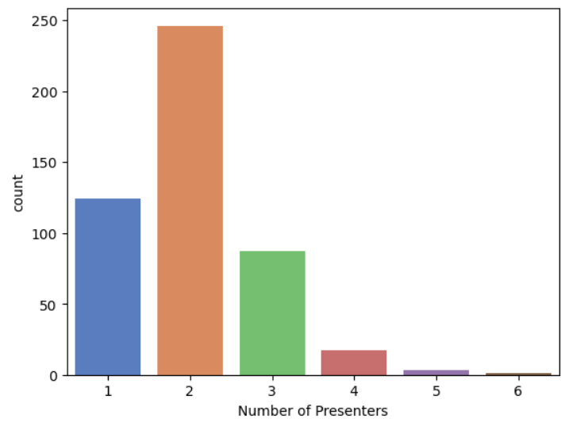
Presenter Details
Gender-wise distribution of business presenter
Insight: Team size of 2 participated most

Slide 13
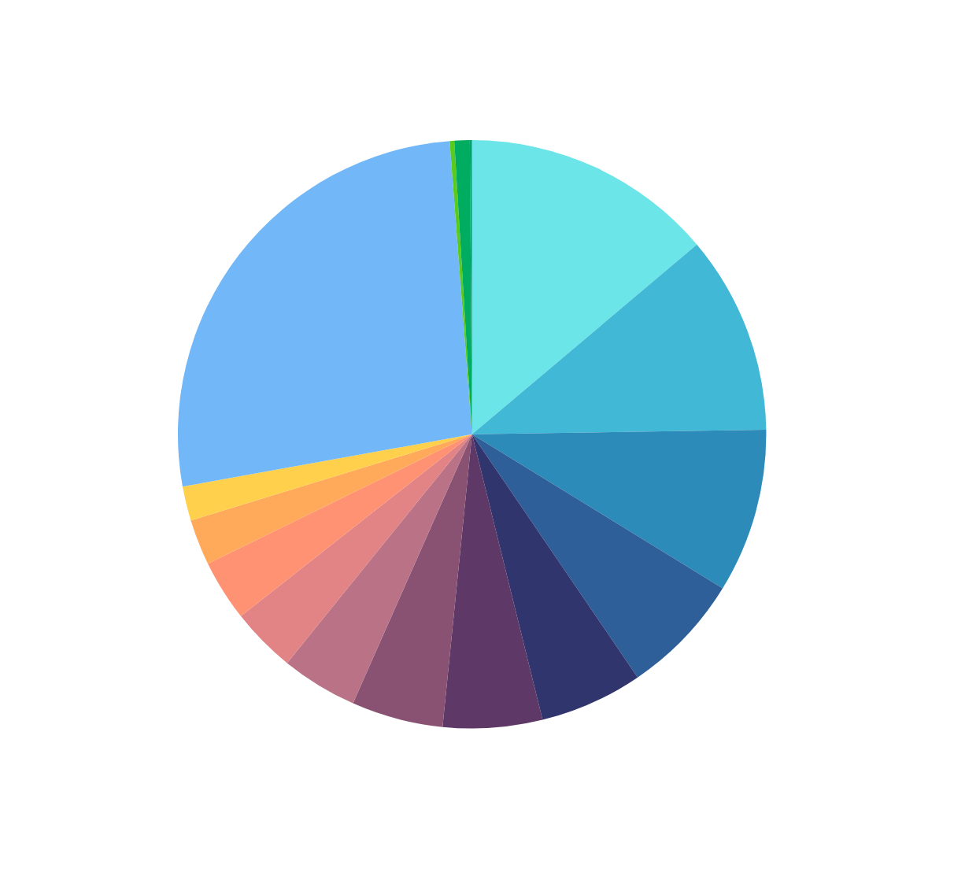
Presenter Details
State-wise distribution of Business emerging

Slide 14

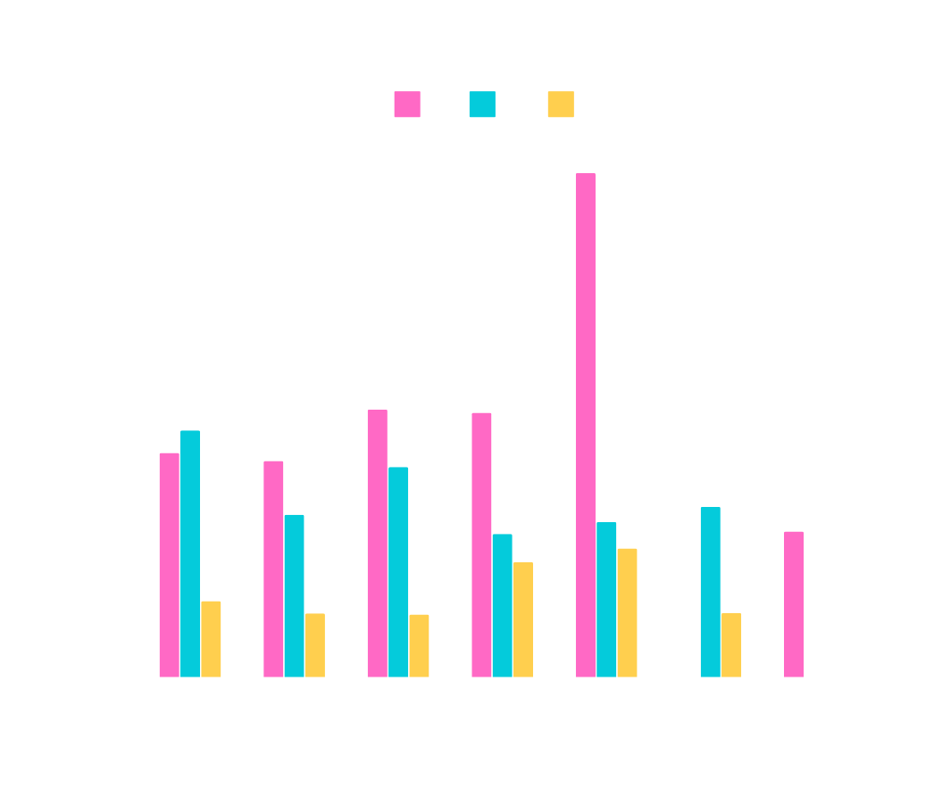

Shark Investment Details
Percentage Equity
Amount in Crores
Shark
Shark
Total Amounts Invested by each shark
Equities gained by each shark

Slide 15


Questions and findings !!
Q. How Many seasons of Shark Tank India were streamed?
Ans : Three
Q. Total number of episodes in each season ?
Ans : Season 1-36 , Season 2-51 , Season 3-52
Q. What was the total number of enterprenuers who presented their ideas in Shark tank India ?
Ans : 478
Q. What was the season-wise distribution of enterpreneurs who presented their idea ?
Ans : S1-152 , S2-169 , S3-157
Q. What was the observaion from sectoral analysis of the data ?
Ans : Entrpreneurs from food industry particpated most while from hardware and entertainment sectors were less.
Q. What can you comment on the team size of the pitchers across seasons ?
Ans : Team of 2 participated most in all season and only one or two team with 5 or 6 members participated in season 2,3 and season 1 respectively.
Q. How many deals were finalised ?
Ans : 230 deals were accepted 181 deals were rejected

Slide 16
Questions and findings !!
Q. Percentage of couple presenters ?
Ans : 17.57 %
Q. What can be concluded from the age distribution of enterpreneurs?
Ans : around 75% of pitchers were of middle age participated mostly middle age participated
Q. What can be concluded from the state origin of ideas and enterpreneurs?
Ans : Top 5 participating states:
Mahrashtra
Delhi
Karnataka
Gujarat
others / miscellaneous
Q. Which were the least and most actively participating zones?
Ans : Most - West zone
Least - Central zone

Slide 17
Questions and findings !!
Q. How many enterprenurs patent their ideas ?
Ans : 435
Q. How many offers were rejected by pitchers ?
Ans : 53
Q. Find the highest deal amount that were accepted ?
Ans : 3 Crore
Q. Find the lowest deal amount that were accepted ?
Ans : It was for Rs. Zero and 100hrs of experience + 0.5% equity.
Q. Which were the most and least expensive episode ?
Ans : most expensive episode :
Episode 15 of season 3, Episode 20 of season 2, Episode 17 of season 1
least expensive episode :
Episode 17 of season 3, Episode 21 of season 2, Episode 18 of season 1
Q. How many sharks participated in this show and What were their names ?
Ans : 7. Namita, Vineeta, Anupam, Aman, Peyush, Amit, Ashneer

Slide 18
Questions and findings !!
Q. How much total amount each investers/sharks invested in the the deals?
Ans : Namita- 29.3Cr , Vineeta- 21.24 Cr, Anupam- 22.19 Cr, Aman- 36.91 Cr, Peyush- 30.85 Cr, Amit- 12.34 Cr, Ashneer- 5.4 Cr
Q. Find the highest deal amount that were accepted ?
Ans : 4.17 % entrepreneurs got more amount than they asked
23.13 % entrepreneurs got less amount than they asked
62.68 % entrepreneurs got same amount as they asked

Slide 19






Conclusion
The thorough EDA conducted on the dataset yielded valuable insights about -
the various business ideas emerging across different sectors
behavioral trends of sharks investment as per industries and the equities gained
season-wise investments into the business
fundings provided to various businesses.

Slide 20




SHARK TANK INDIA
Thank You
Contact Us
+91 9301430004
sahuadarsh031@gmail.com

